Slide 1

IT Essentials (CompTIA A+) Ch. 23
The Internet

Slide 2
Overview
In this chapter, you will learn how to:
Explain how the Internet works
Connect to the Internet
Use Internet application protocols
Troubleshoot an Internet connection
Notes:
2
Instructor Tip
When gaining attention and establishing common ground, ask questions of the class such as, “How many of you have Internet access at home?” or “What services do you use on the Internet?”
For a positive statement, tell the class, “In this lesson, we are going to learn how the Internet works, various ways that you can connect to it, and what you can do while on the Internet.”

Slide 3
How the Internet Works
Internet Tiers
To keep everything running smoothly, the Internet is broken down into groups called tiers.
Tier 1 (main tier)
A small number of companies are Tier 1 providers, which own long-distance, high-speed fiber-optic networks called backbones.
Backbones span the major cities of the earth and interconnect at network access points (NAPs).
Notes:
3

Slide 4
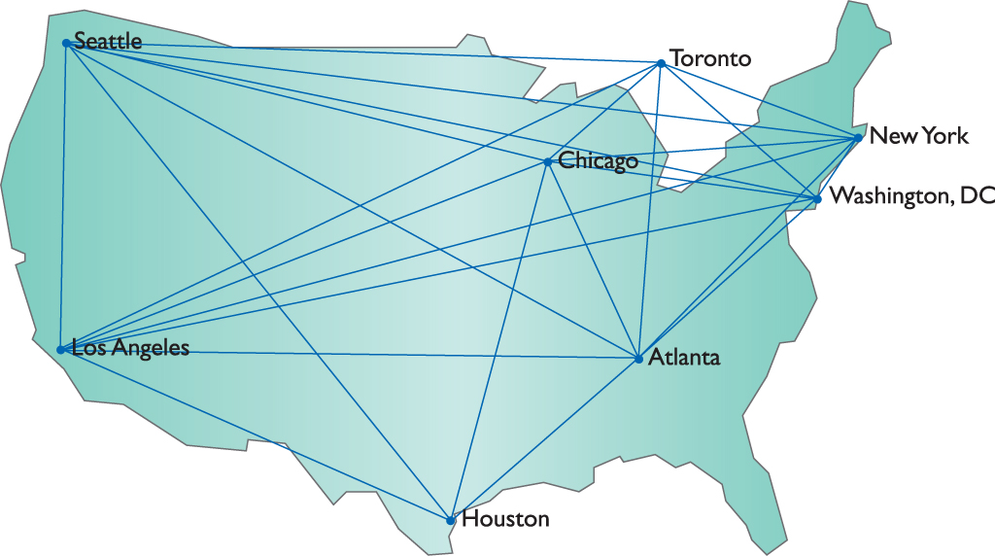
Internet Tiers
Figure 23.1 Internet Tier 1 connections

Slide 5
Internet Tiers
Tier 2
Smaller regional networks
Tier 3
Even more regional networks
Built-in redundancy
Backbone routers connect to more than one other backbone router.
Decentralized and interwoven nature of the Internet
Alternative pathways for data if one or more of the routers fail
Notes:
5

Slide 6
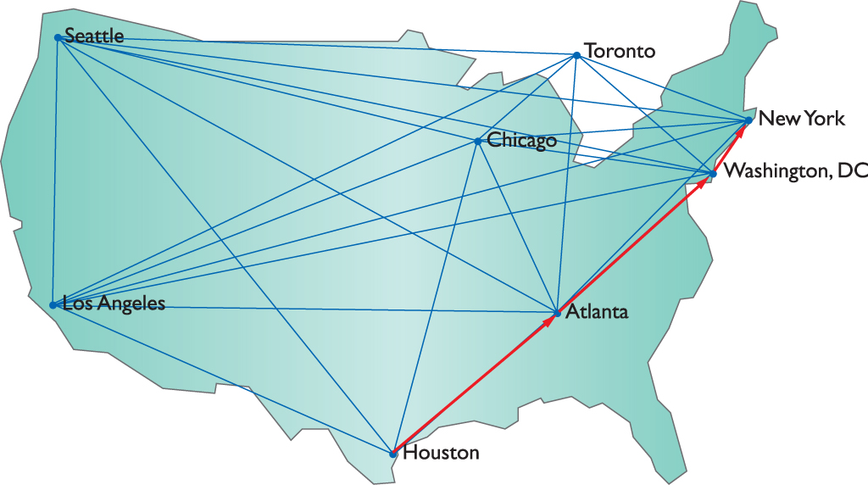
Internet Tiers
Figure 23.2 Message traveling from Houston to NYC

Slide 7
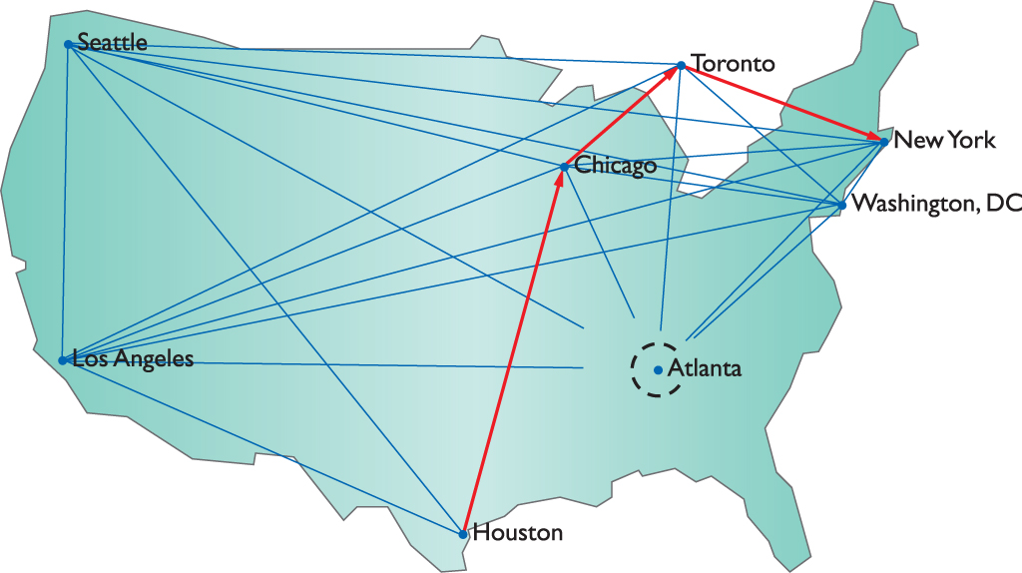
Internet Tiers
Figure 23.3 Rerouted message from Houston to NYC

Slide 8
TCP/IP
TCP/IP provides the basic software structure for communication on the Internet.
TCP/IP provides the framework and common language for the Internet.
All the backbone routers connect redundant, high-speed backbone lines.
TCP/ IP enables communication and services for building applications.
Enable humans and machines to interface across vast distances
Notes:
8

Slide 9
Internet Service Providers
Internet service providers (ISPs) gain access to the Internet from leased Tier 1 and Tier 2 connections.
ISPs come in many sizes:
National companies such as Comcast
Local shops such as Electric Power Board (EPB) of Chattanooga in Tennessee
Notes:
9

Slide 10
Connection Concepts
Connecting to an ISP requires:
Hardware for connectivity
Software (protocols)
Governs the connection and data flow.
With most ISPs, a DHCP server will provide your computer with the proper TCP/IP information.
The router to which you connect at the ISP is the default gateway.
Notes:
10

Slide 11
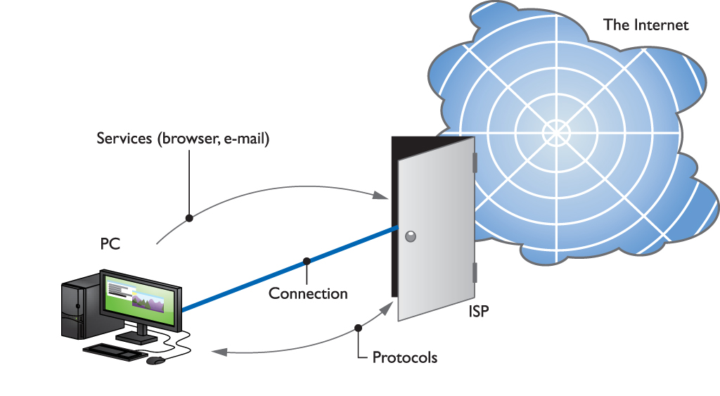
Connection Concepts
Figure 23.5 Simplified Internet connectivity

Slide 12
Connecting to the Internet
Computers commonly connect to an ISP by using one of eight technologies that fit into four categories:
Dial-up
Analog and ISDN
Dedicated
DSL, cable, and fiber
Wireless
Wi-Fi and cellular
Satellite

Slide 13
Dial-Up
A dial-up connection to the Internet requires:
Hardware to dial the ISP, such as a modem or ISDN terminal adapter
Software to govern the connection, such as Microsoft’s Dial-up Networking (DUN).
Modems enable computers to communicate via standard commercial telephone lines.
Modems convert analog signals to digital signals, and vice versa.
Phone lines have a speed based on a unit called a baud, which is one cycle per second.
Notes:
13

Slide 14
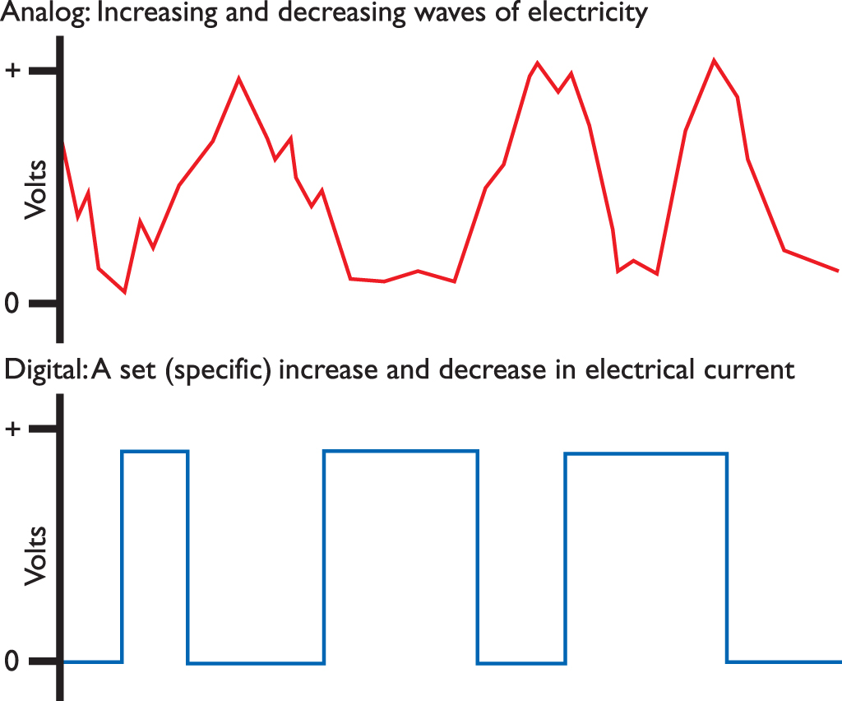
Dial-Up
Figure 23.6 Analog signals used by a telephone line
versus digital signals used by the computer

Slide 15
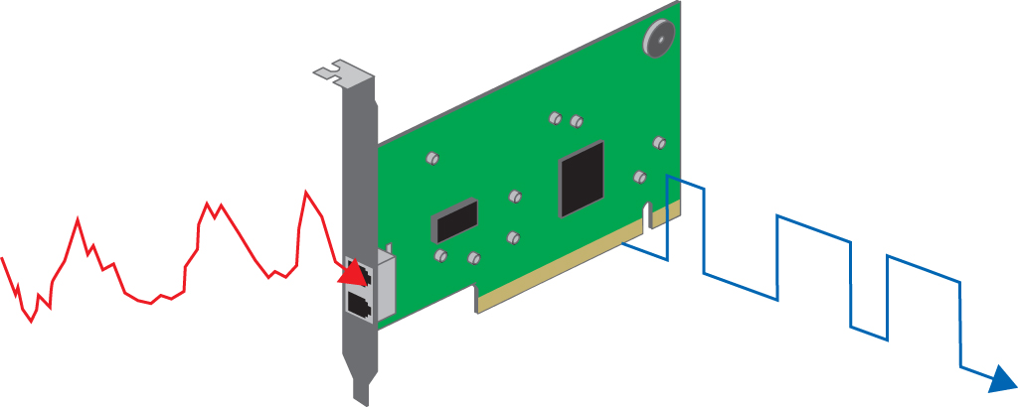
Dial-Up
Figure 23.7 Modem converting analog signal to digital signal

Slide 16
Dial-Up
Modem connections
Modems connect to the PC in one of two ways:
Internal modems connect to a PCI or PCI Express (PCIe) expansion bus slot.
Contemporary external modems connect to the computer through an available USB port
Notes:
16
Exercise
Installing a Modem
Have the students install a modem and its drivers. After they install the modem, ensure that it is working using the Device Manager.

Slide 17
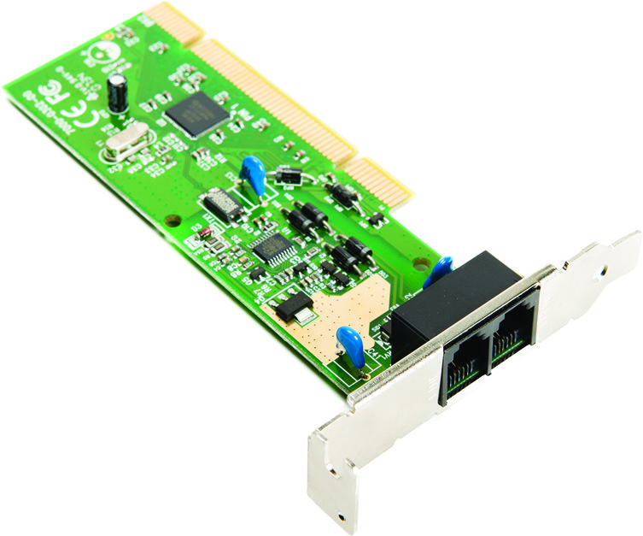
Dial-Up
Figure 23.8 An internal modem

Slide 18
Dial-Up
Dial-up networking
The software side of dial-up networks requires configuration within the OS to include information provided by your ISP.
Dial-up links to the Internet have their own special hardware protocol called Point-to-Point Protocol (PPP).
Notes:
18

Slide 19
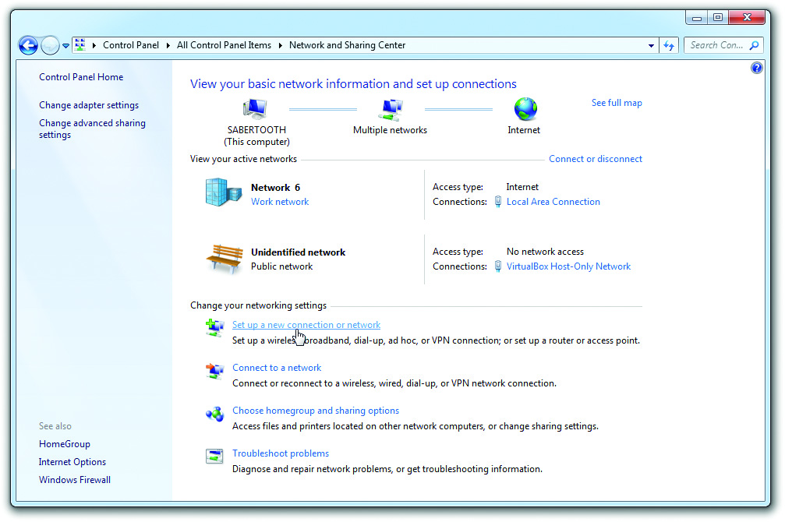
Dial-Up
Figure 23.10 Setting up a new connection or network in Windows 7

Slide 20
Dial-Up
Integrated Services Digital Network (ISDN)
ISDN service consists of two types of channels.
Bearer (B) channels carry data and voice at 64 Kbps.
Delta (D) channels carry setup and configuration information at 16 Kbps.
ISDN providers allow users to choose either one or two B channels.
Basic Rate Interface (BRI) is the most common setup with two B/one D.
ISDN uses a terminal adapter to interface with a computer.
Notes:
20
Discussion Points
ISDN requires special equipment at the central office and user’s location to make that last bit of copper fully digital.
ISDN service consists of two types of channels: Bearer or B channels and Delta or D channels. B channels carry data and voice information at 64 Kbps. D channels carry setup and configuration information and carry data at 16 Kbps. Most providers of ISDN allow the user to choose either one or two B channels. The more common setup is two B/one D, usually called a Basic Rate Interface (BRI) setup. A BRI setup uses only one physical line, but each B channel sends 64 K, doubling the throughput total to 128 K. ISDN also connects much faster than modems, eliminating that long, annoying noise you get with modems. The monthly cost per B channel is slightly more than a regular phone line, and there is usually a fairly steep initial cost for the installation and equipment. The big limitation is that you usually need to be within about 18,000 feet of a central office to use ISDN.
T1 Line
Discuss the Primary Rate Interface (PRI), a type of ISDN. Ask the students why PRI ISDN lines are rarely used as dial-up connections.
PRI is composed of twenty-three 64-Kbps B channels and one 64-Kbps D channel, giving it a total throughput of 1.5 Mbps. PRI ISDN lines are rarely used as dial-up connections—they are far more common on dedicated lines.

Slide 21
DSL
Digital subscriber line (DSL)
DSL uses a regular phone line but special equipment at both ends.
Service levels can vary widely.
Installation requires a DSL receiver (often called a DSL modem).
Must be within 18,000 feet of the closest main phone service switching center
Notes:
21
The two most common forms of DSL you’ll find are asynchronous (ADSL) and synchronous (SDSL). ADSL lines differ between slow upload speed (such as 128, 256, or 384 Kbps) and faster download speed (usually 2 Mbps). SDSL has the same upload and download speeds, but telecom companies charge a lot more for the privilege. DSL encompasses many such variations, so you’ll often see it referred to as xDSL.

Slide 22
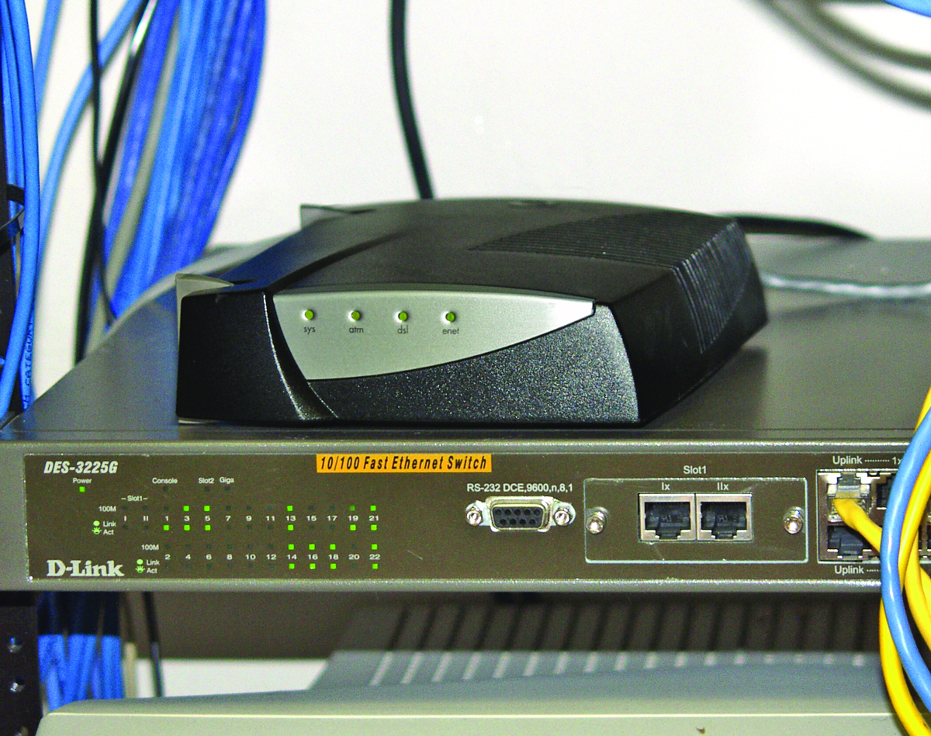
DSL
Figure 23.12 A DSL receiver

Slide 23
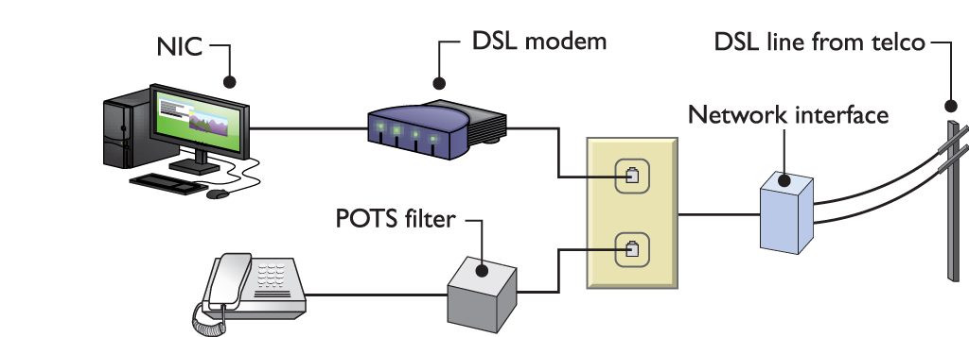
DSL
Figure 23.13 DSL connections

Slide 24
Cable
Cable Internet connections are theoretically available anywhere you can get cable TV.
Cable Internet connections start with an RG-6 or RG-59 cable coming into your house.
The cable connects to a cable modem that then connects to a small home router or your network interface card (NIC) via Ethernet.
Notes:
24
The term modem has been warped and changed beyond recognition in modern networking. Both DSL and cable, which are fully digital Internet connections, use the term modem to describe the box that takes the incoming signals from the Internet and translates it into something the PC can understand.

Slide 25
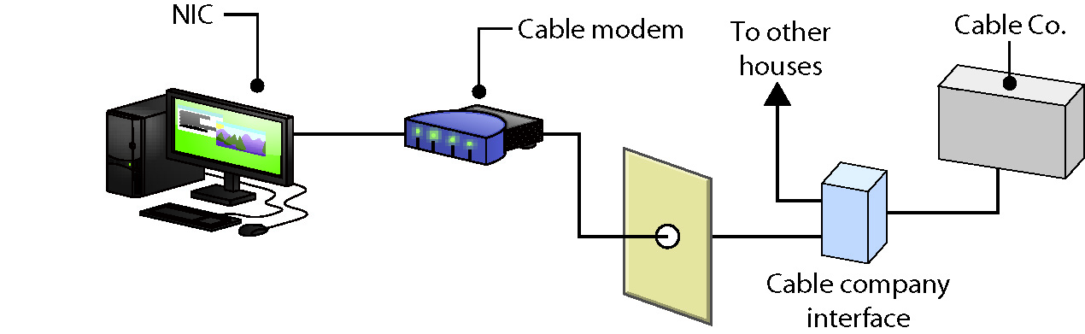
Cable
Figure 23.14 Cable connections

Slide 26
Fiber
DSL providers have developed fiber-to-the-node (FTTN) and fiber-to-the-premises (FTTP) services provide Internet and more.
With FTTN, the fiber connection runs from the provider to a box somewhere in your neighborhood.
This box is connected to your home or office using normal coaxial or Ethernet cabling.
Notes:
26

Slide 27
Fiber
FTTP runs from the provider straight to a home or office, using fiber the whole way.
Once inside the home or office, you can use any standard cabling (or wireless) to connect your PCs to the Internet.
One popular FTTN service is AT&T’s U-verse, which generally offers download speeds from 1 to 75 Mbps and upload speeds from 384 Kbps to 8 Mbps.
Verizon’s FiOS service is the most popular and widely available FTTP service in the United States, providing upload and download speeds ranging from 25 Mbps to 500 Mbps.
Notes:
27

Slide 28
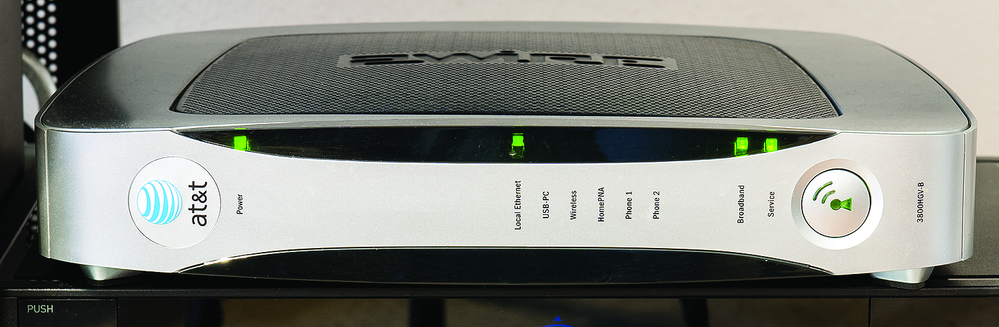
Fiber
Figure 23.15 U-verse gateway

Slide 29
Wi-Fi
Wi-Fi (or 802.11 wireless) is so prevalent that it’s the way many of us get to the Internet.
Wi-Fi works well as an Internet access option for densely populated areas.
Wi-Fi’s short range makes it impractical in areas where it’s not easy to place new access points.

Slide 30
Cellular
First-generation devices are called 1G, second-generation are 2G, followed by 3G and 4G.
The first generation (1G) of cell phone data services was analog and not at all designed to carry packetized data.
We’re now well into 4G technology.
Devices and networks using Long Term Evolution (LTE) technology
Theoretical speeds of up to 300 Mbps download and 75 Mbps upload
Notes:
30

Slide 31
Cellular
LTE can readily replace wired network technology.
You don’t need a physical connection to an ISP.
You can connect to a wireless hotspot—a device that connects via cellular and enables other devices to access the Internet.
Notes:
31

Slide 32
Satellite
Satellite connections to the Internet get the data beamed to a satellite dish.
A receiver handles the flow of data, and sends the data through an Ethernet cable to the NIC in your computer.
The distance the signal must travel creates a small delay called the satellite latency.
Notes:
32

Slide 33
Satellite
Satellite connection involves a dish with line-of-sight to the satellite.
A coax cable runs from the dish to your satellite modem.
The satellite modem has an RJ-45 connection, which you connect directly to your computer or to a router.
Notes:
33

Slide 34
Connection to the Internet
The two choices for your Internet connection are:
Connecting a single computer
Connecting a network of computers
All home routers use a technology called Network Address Translation (NAT):
NAT presents an entire LAN of computers to the Internet as a single machine by showing only your public IP address.
NAT acts as a firewall, protecting your internal network from probing or malicious users.

Slide 35
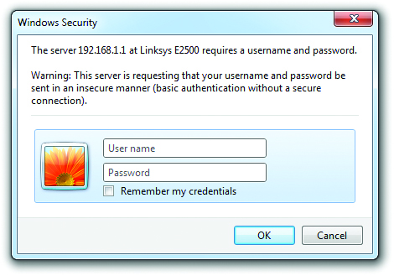
Basic Router Configuration
Figure 23.19 Router asking for user name and password

Slide 36
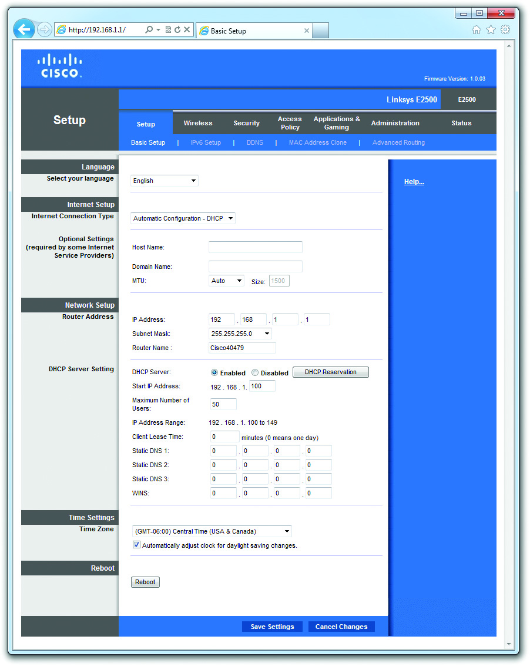
Basic Router Configuration
Figure 23.20 Configuration home page

Slide 37
Basic Router Configuration
Changing user name and password
One of the first changes to your router after you have it working is to change the user name and password to something other than the default.
Especially important if open wireless is turned on
Setting static IP address
Most ISPs enable you to order a static IP (for an extra monthly charge).

Slide 38
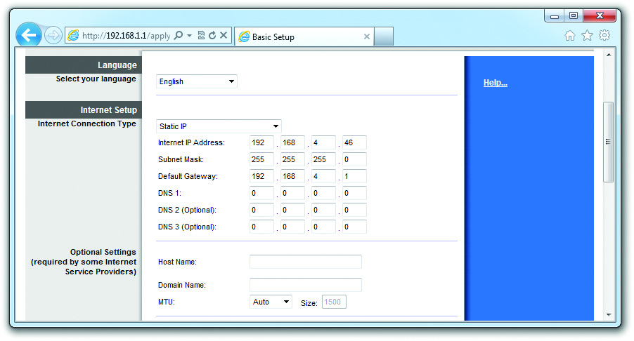
Basic Router Configuration
Figure 23.22 Entering a static IP address

Slide 39
Basic Router Configuration
Updating firmware
Router manufacturers release “firmware updates” and make them available either through the router’s administration interface or on their Web sites for easy download.
A firmware update gone bad can brick your router, that is, render the hardware inoperable.

Slide 40
Internet Application Protocols
To surf the Web, you need an application called a Web browser, such as Mozilla Firefox, Google Chrome, or Microsoft Edge.
All Web browsers use the Hypertext Transfer Protocol (HTTP).
There are methods for encrypting information, the most common being Hypertext Transfer Protocol Secure (HTTPS).
Uses port 443

Slide 41
Internet Application Protocols
Table 23.1 | Application Protocol Port Numbers
Application Protocol |  | Function | Port Number
HTTP |  | Web Pages | 80
HTTPS |  | Secure Web pages | 44.
FTP |  | File transfer | 20, 21
SFTP |  | Secure file transfer | 22
IMAP |  | Incoming e-mail | 143
POP3 |  | Incoming e-mail | 110
SMTP |  | Outgoing e-mail | 25
Telnet |  | Terminal emulation | 23
SSH |  | Encrypted terminal emulation | 22
RDP |  | Remote Desktop | 3389
SIP |  | Voice over IP | 5060

Slide 42
Internet Application Protocols
Table 23.2 | Utility Protocol Port Numbers
Utility Protocol |  | Function |  | Port Number
DNS |  | Allows the use of DNS naming | UDP | 53
DHCP |  | Automatic IP addressing | UDP | 67, 68
LDAP |  | Querying directories | TCP | 389
SNMP |  | Remote management of network devices | UDP | 161
SMB |  | Windows naming/folder sharing; also CIFS | TCP | 445
 |  |  | UDP | 137. 138. 139
AFP |  | Mac OS X file services | TCP | 548
SLP |  | Services discovery protocol | TCP/UDP | 427

Slide 43
The World Wide Web
The World Wide Web (Web) provides a graphical face for the Internet.
Web servers house Web sites.
Using a Web browser, you can click a link on a Web page and be instantly transported to anywhere in the world.
Notes:
43

Slide 44
Configuring Internet Explorer
Web browsers are highly configurable.
Can set the default font size, choose whether to display graphics, and adjust several other settings
Internet Explorer (IE) comes with Windows versions up to 8.1.

Slide 45
Configuring Internet Explorer
Internet Options applet displays the Internet Properties window to allow changes.
The General tab includes settings to control the most basic features of Internet Explorer: the home page, tab management, your browsing history, searching, and other appearance controls.
The Security tab enables you to set Internet Explorer’s security level for a particular zone, such as the Internet, your local intranet, trusted sites, and restricted sites.
The Privacy tab has settings for privacy matters.

Slide 46
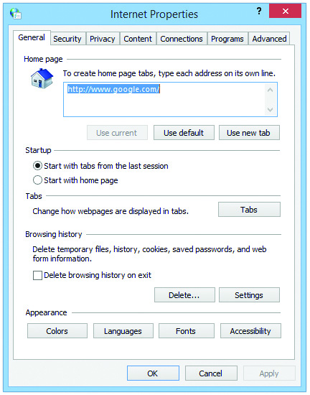
Configuring Internet Explorer
Figure 23.26 Internet Options applet

Slide 47
Configuring Internet Explorer
The Content tab controls what your browser will and will not display.
Settings enable you to gate access to insecure or objectionable sites—called content filtering.
Uses certificates and a parental-control tool called Family Safety
System administrators restrict Web, game, and app usage (by rating system and exception lists) and control when an account can log in.
Many corporations use software called a proxy server to filter employee Internet access.

Slide 48
Configuring Internet Explorer
The Programs tab contains settings for:
Your default Web browser
Any add-ons such as Java
How other programs deal with HTML files and e-mail messages
The Advanced tab provides settings for advanced options including accessibility, browsing, international, and security settings.

Slide 49
Configuring Other Web Browsers
Microsoft Edge is available in Windows 8.1 and later.
Mozilla Firefox and Google Chrome allow you to control their settings much like you do in Internet Explorer.
However, you won’t find an applet tucked away in Control Panel.

Slide 50
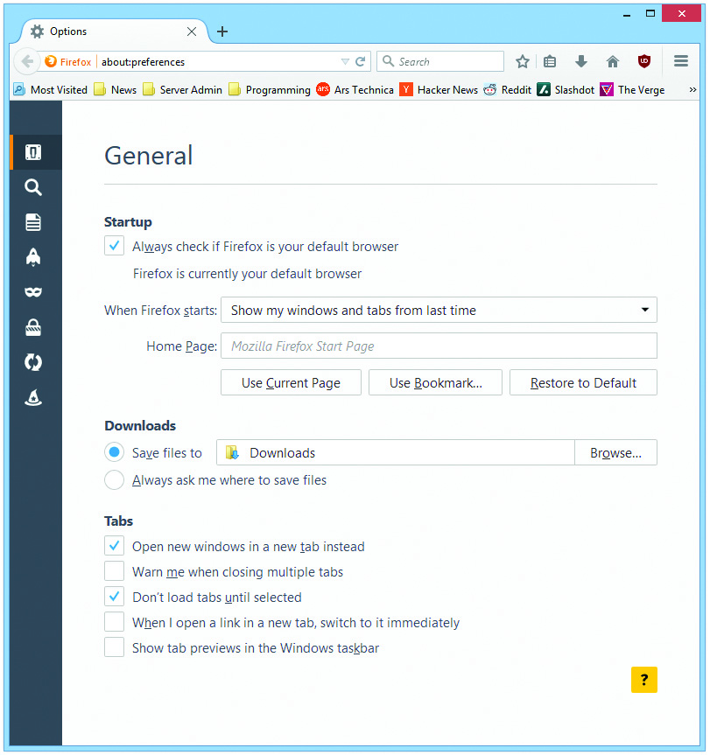
Configuring Other Web Browsers
Figure 23.29 Mozilla Firefox Options

Slide 51
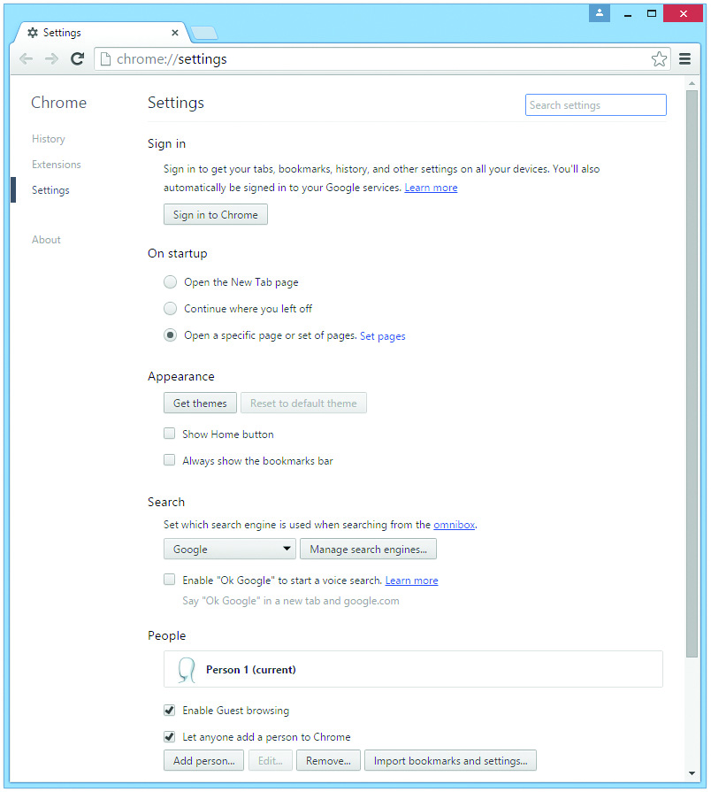
Configuring Other Web Browsers
Figure 23.30 Google Chrome settings

Slide 52
E-mail
Corporate/ISP solutions
Set up your client software to match the settings of the e-mail server software.
The most popular client by far is Microsoft Outlook.
You’ll need the names of the Post Office Protocol version 3 (POP3) or Internet Message Access Protocol version 4 (IMAP4) server and the Simple Mail Transfer Protocol (SMTP) server.
Use ping to determine the IP address for the device.
Notes:
52

Slide 53
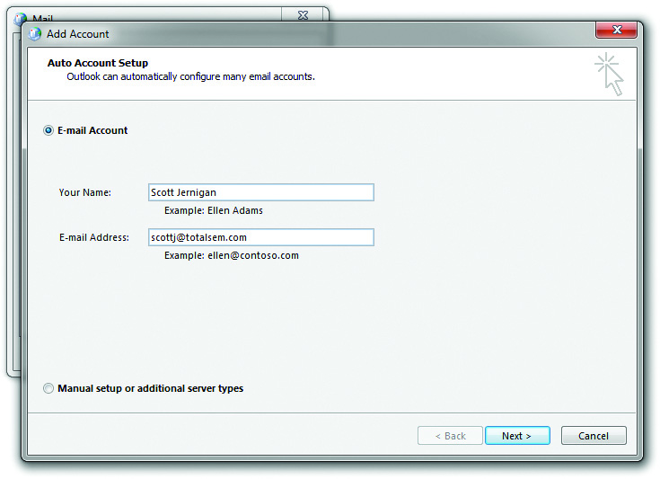
E-mail
Figure 23.31 Adding an account with the Mail applet in Control Panel

Slide 54
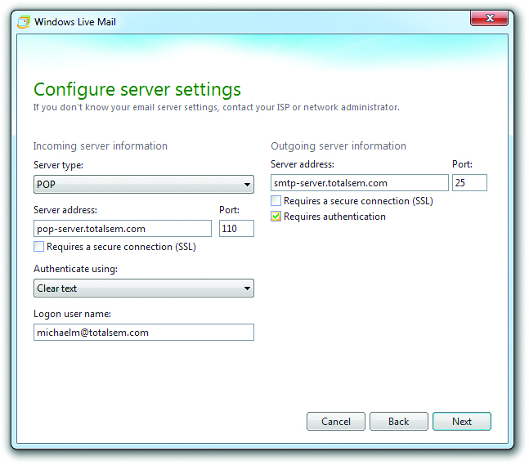
E-mail
Figure 23.33 Adding POP3 and SMTP information in Windows Live Mail

Slide 55
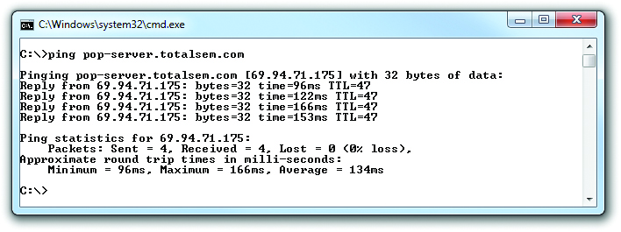
E-mail
Figure 23.34 Using ping to determine the IP address

Slide 56
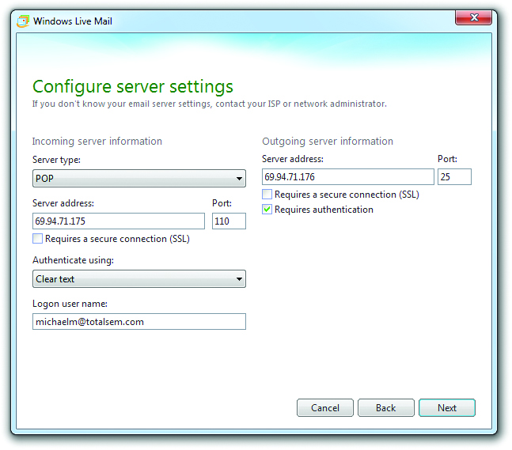
E-mail
Figure 23.35 Entering IP addresses into POP3 and SMTP settings

Slide 57
E-mail
Integrated solutions
All mobile devices have an integrated e-mail client, fully configured to work within the mobile ecosystem.
Web mail
Popular Web-based e-mail options include:
Yahoo! Mail, Gmail from Google, and Outlook.com from Microsoft
Unified internet accounts
Microsoft calls this feature Live sign in.

Slide 58
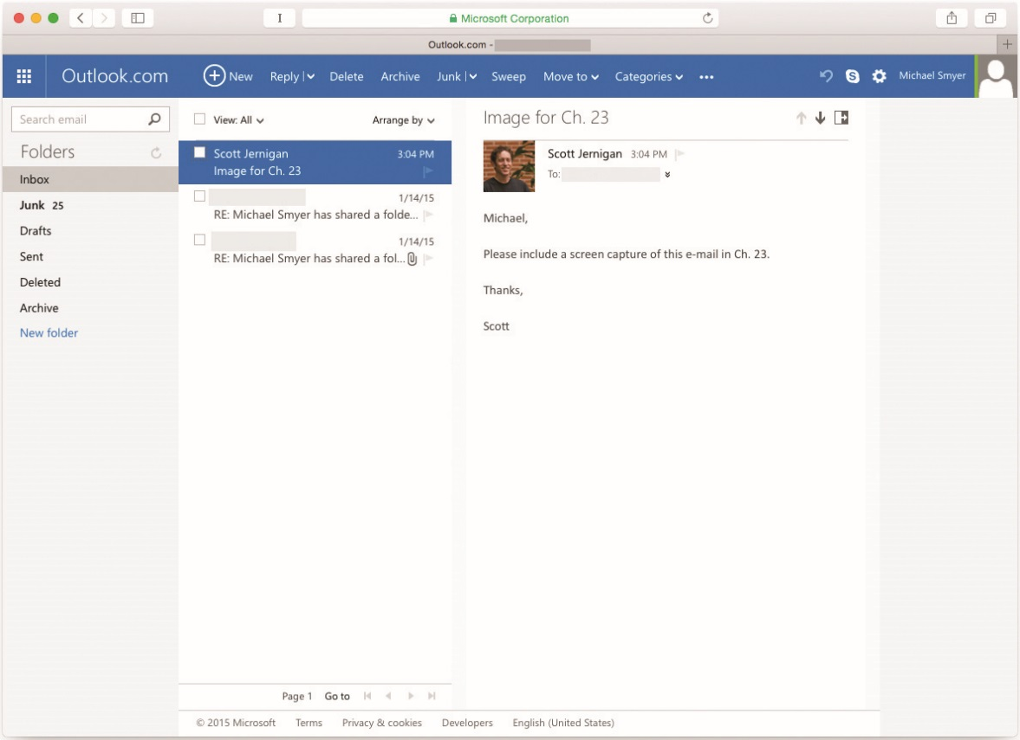
E-mail
Figure 23.38 Web-based e-mail

Slide 59
FTP
File transfer protocol (FTP), using ports 20 and 21, is a great way to share files between systems.
FTP server software exists for most operating systems.
To access an FTP site, you must use an FTP client such as FileZilla.
FTP requires logon.
A Web browser will assume you want to log on as “anonymous,” which works fine for public FTP sites.
User name and password are sent in clear text
Notes:
59
Exercise
Using Internet Tools
This exercise should allow the students to explore as many of the Internet tools as possible, including the World Wide Web, e-mail, FTP, newsgroups, and Telnet. Ask students to create a new Web-based e-mail account to exploring other services. You may want to specify addresses for the students to view certain Web pages, to download a program from an anonymous FTP site, or to access newsgroups.

Slide 60
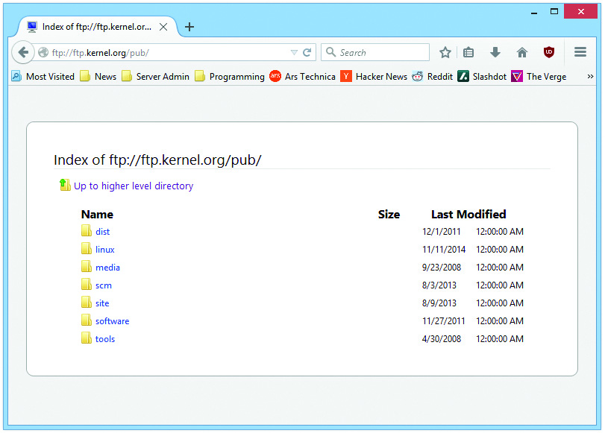
FTP
Figure 23.40 Accessing an FTP site in Firefox

Slide 61
Telnet and SSH
Telnet is a terminal emulation program for TCP/IP networks that uses port 23.
Enables you to connect to a server or fancy router and run commands on that machine as if you were sitting in front of it
If you need a remote terminal that works securely across the Internet, you need Secure Shell (SSH).
SSH uses port 22, and the entire connection is encrypted (tunneling).
Notes:
The A+ Certification exams test knowledge of a few networking tools, such as Telnet, but only enough to let you support a Network+ tech or network administrator. If you need to run Telnet, you will get the details from a network administrator. Implementation of Telnet falls well beyond A+.

Slide 62
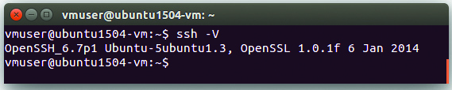
SFTP
Secure FTP is nothing more than FTP running through an SSH tunnel, using any one of several methods.
Figure 23.42 OpenSSH

Slide 63
VoIP
You can use Voice over IP (VoIP) to make voice calls over your computer network.
VoIP refers to a collection of protocols that make phone calls over the data network possible.
Low network latency is more important than high network speed.
Latency is the amount of time a packet takes to get to its destination and is measured in milliseconds.
Two popular ways to set up a VoIP system are:
Using dedicated VoIP phones
Or using a small VoIP phone adapter

Slide 64
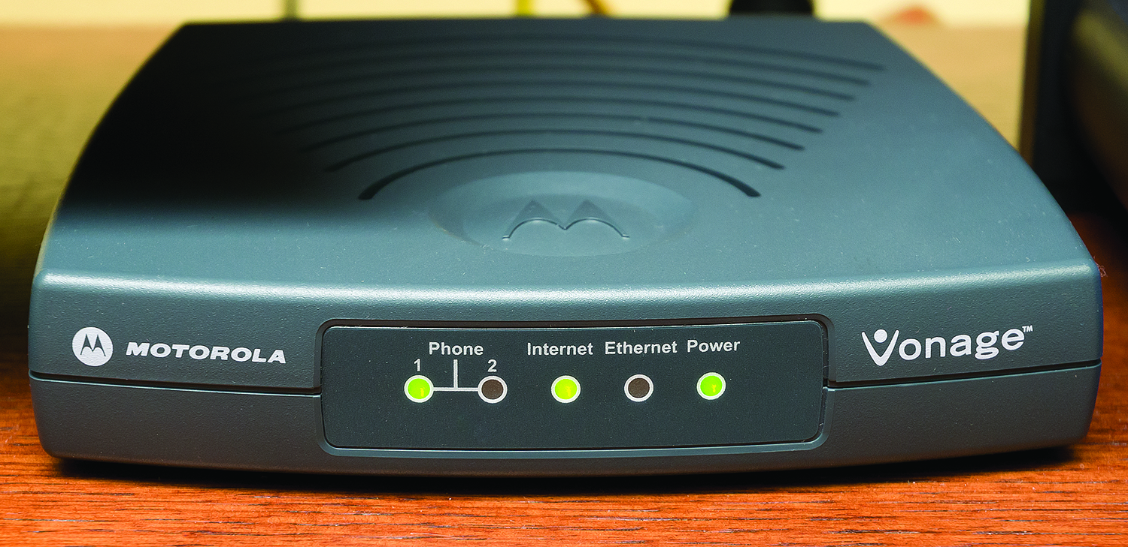
VoIP
Figure 23.43 Vonage Box VoIP phone adapter

Slide 65
Remote Desktop
Enables access to other computers as if you were there
Some operating systems include a remote desktop client.
Many third-party remote desktop applications are also available.
Most of these make use of either the Remote Desktop Protocol (RDP) or Virtual Network Computing (VNC).
Notes:
65

Slide 66
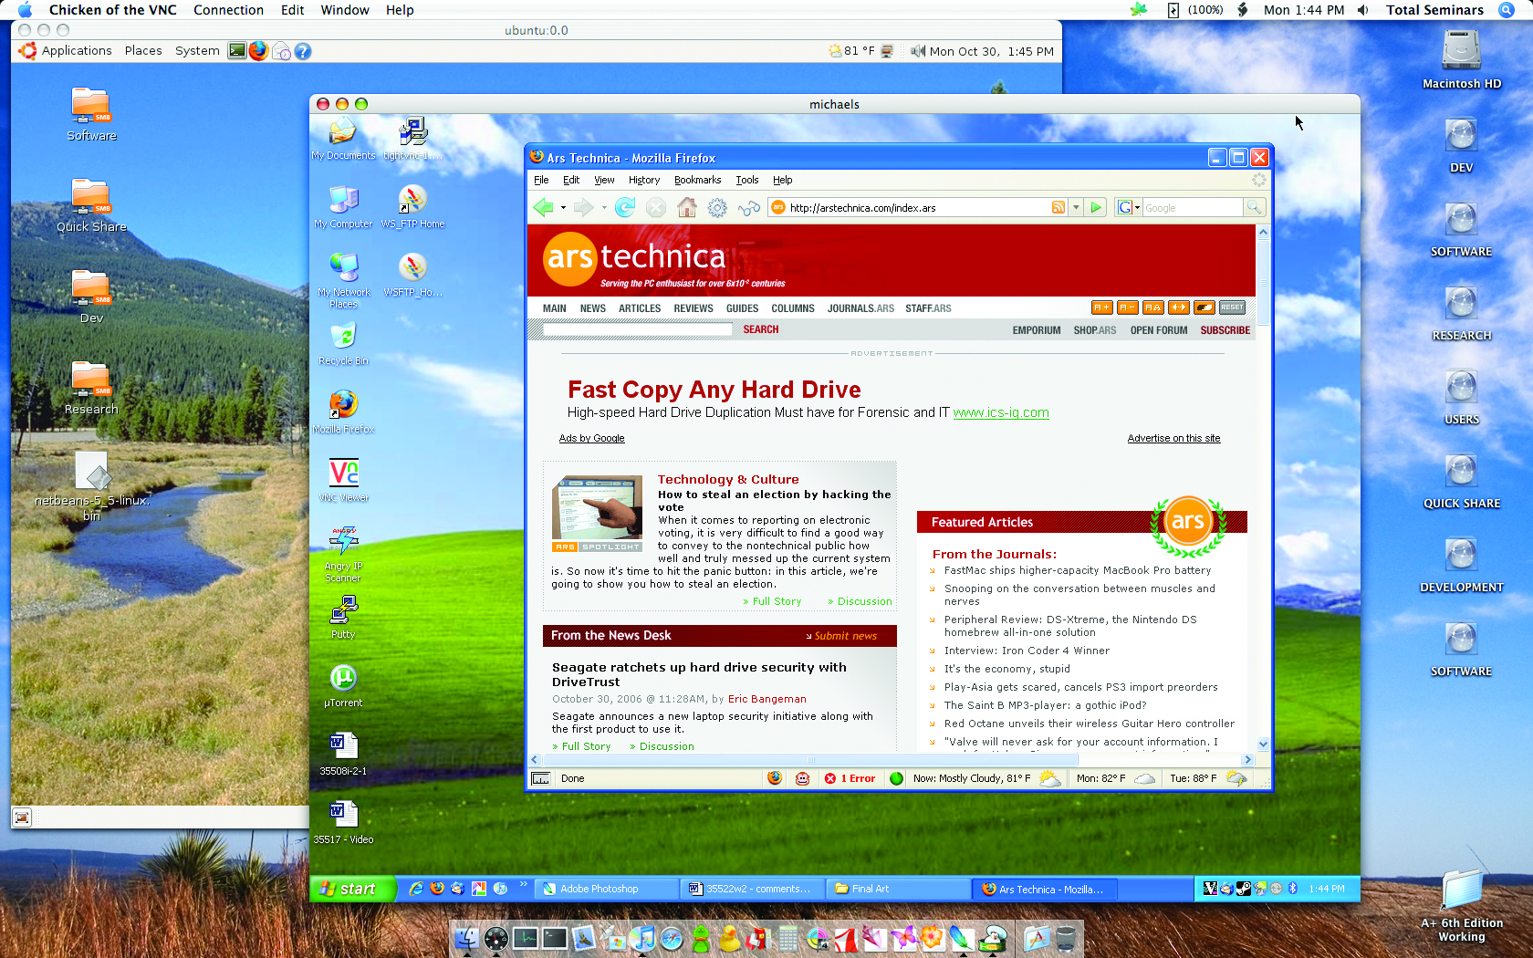
Remote Desktop
Figure 23.44 TightVNC in action

Slide 67
Remote Desktop
Windows offers an alternative to VNC:
Remote Desktop Connection provides control over a remote server with a fully graphical interface.
Remote Assistance enables you to give anyone control of your desktop or take control of anyone else’s desktop.
If a user has a problem, that user can send you a support-request e-mail.
You can then log on to the user’s system and, with permission, take the driver’s seat.
Notes:
67
Note: The name of the Remote Desktop executable file is mstsc.exe. You can also open Remote Desktop from a command-line interface by typing mstsc and pressing ENTER.

Slide 68
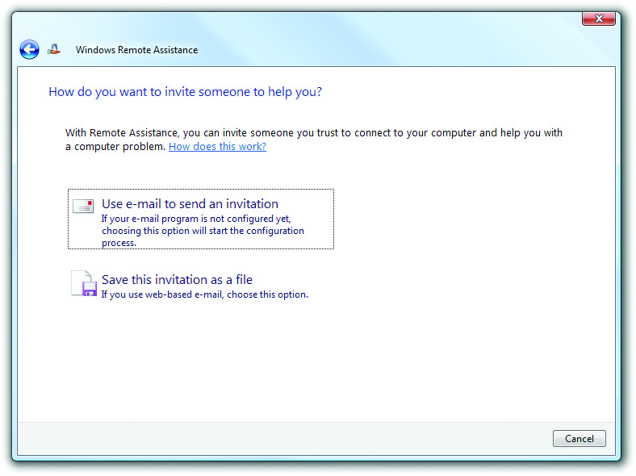
Remote Desktop
Figure 23.46 Remote Assistance in action

Slide 69
Virtual Private Networks (VPN)
A Virtual Private Network (VPN) allows you to connect to a private network via the Internet.
Either some software running on a computer or, in some cases, a dedicated box must act as an endpoint for a VPN.
VPNs require a protocol that itself uses one of the many tunneling protocols available.
Adds the capability to ask for an IP address from a local DHCP server to give the tunnel an IP address that matches the subnet of the local LAN

Slide 70
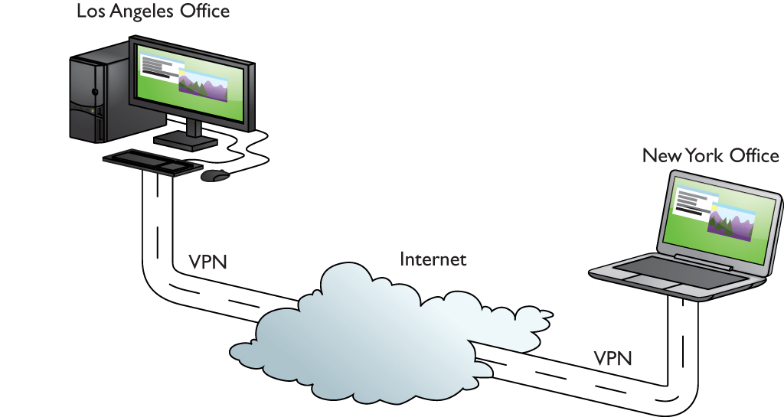
Virtual Private Networks (VPN)
Figure 23.47 VPN connecting computers across the United States

Slide 71
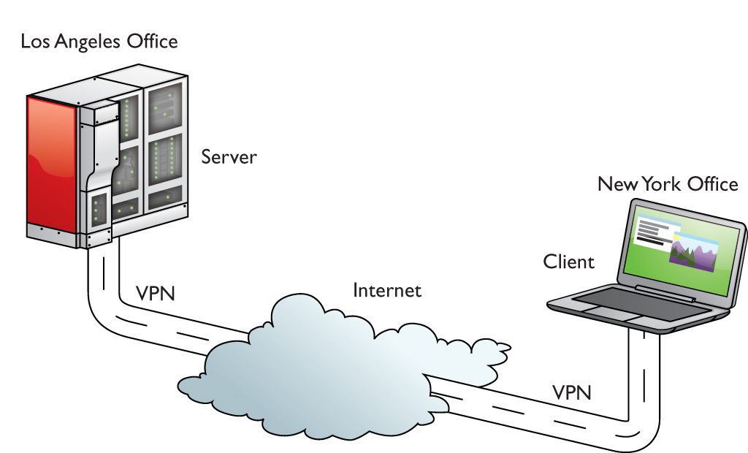
Virtual Private Networks (VPN)
Figure 23.48 Typical tunnel

Slide 72
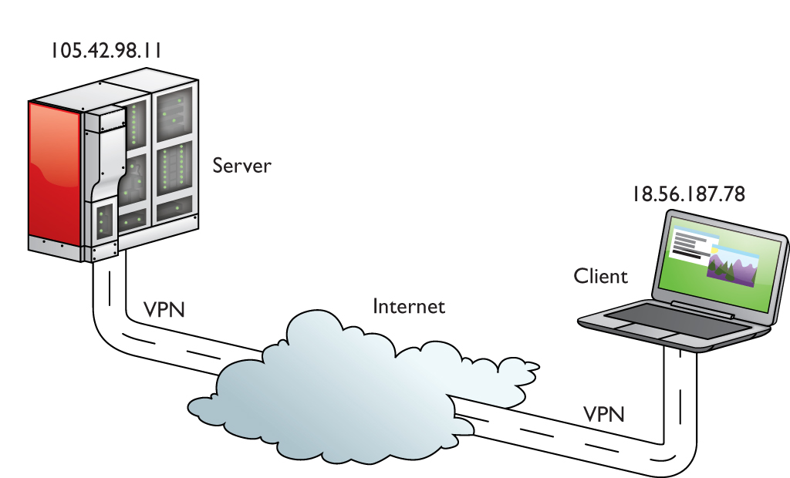
Virtual Private Networks (VPN)
Figure 23.49 Endpoints must have their own IP addresses.

Slide 73
Virtual Private Networks (VPN)
PPTP VPNs
Microsoft developed Point-to-Point Tunneling Protocol (PPTP), an advanced version of PPP (used for dial-up Internet, as discussed earlier) that handles a VPN connection right out of the box.
Microsoft places the PPTP endpoints on the client and a special remote access server program called Routing and Remote Access Service (RRAS), available on Server versions of Windows.

Slide 74
Support Applications (Internet Utilities)
LDAP
The Lightweight Directory Access Protocol (LDAP) enables operating systems and applications to access distributed directories.
Windows uses LDAP to work with Active Directory.
SNMP
The Simple Network Management Protocol (SNMP) enables remote query and remote configuration of just about anything on a network, including computers, switches, routers, and anything else that is SNMP-capable.

Slide 75
Support Applications (Internet Utilities)
SMB
The Server Message Block (SMB) protocol is Windows’ network file and print sharing protocol.
UNIX and Linux systems used a competing protocol, Network File System (NFS).
NFS has declined.
Today, every major OS uses SMB.
AFP
Apple developed the Apple Filing Protocol (AFP) in the late 1980s to support file sharing between Macintosh computers on early LANs.

Slide 76
Support Applications (Internet Utilities)
SLP
Devices use the Service Location Protocol (SLP) to advertise available services over a local network and to discover those services.
You will see this most commonly with network-aware print devices, although some OSs use SLP with file shares as well.

Slide 77
Internet Troubleshooting
No connectivity
“No connectivity” has two meanings:
A disconnected NIC
An inability to connect to a resource
In the case of “you’re on the Internet but you can’t get to a Web site, try these tests:
Can you get to other websites? If not, go back and triple-check your local connectivity
Can you ping the site? If the ping is a fail, this points to a DNS failure.

Slide 78
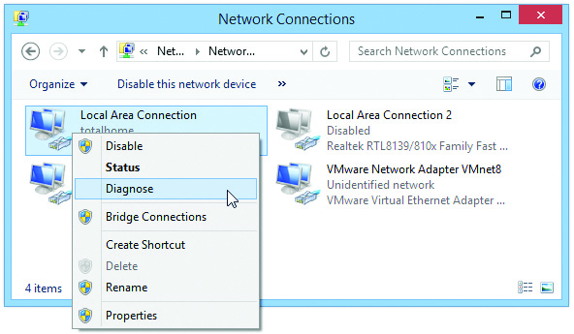
Internet Troubleshooting
Figure 23.53 Diagnosing a network problem in Windows 8.1

Slide 79
Limited Connectivity
Limited connectivity points to a DHCP problem, assuming you’re connected to a DHCP server.
Run ipconfig and see if you have an APIPA address.
If you do, you either have problems with the DHCP server or you are not connected to the network.

Slide 80
Local Connectivity
Local connectivity means you can access network resources but not the Internet.
This is a classic symptom of a downed DHCP server.
You might also have a problem with your router.
Ping your default gateway to see if it responds.
If it’s successful, look at its configuration through a the router’s configuration Web page—especially the WAN side connection.

Slide 81
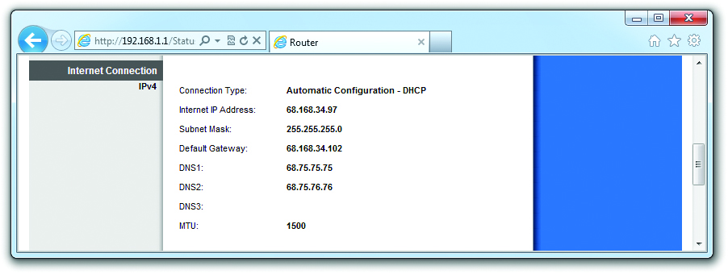
Local Connectivity
Figure 23.54 Router’s WAN IP address

Slide 82
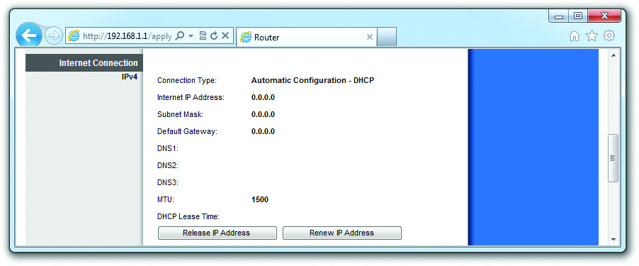
Local Connectivity
Figure 23.55 No WAN connection

Slide 83
Slow Transfer Speeds
Your Internet connection has a maximum speed at which it can transfer.
If you divide that connection between multiple programs trying to use the Internet, all of your programs will connect very slowly.
Open a command prompt and type netstat, which shows all the connections between your computer and any other computer.

Slide 84
Slow Transfer Speeds
If everyone on the network is getting slow Internet connectivity, check the router.
You can control what’s going through your router using Quality of Service (QoS).
QoS enables you to limit the bandwidth for certain types of data based on application protocol, the IP address of a computer, and other criteria.

Slide 85
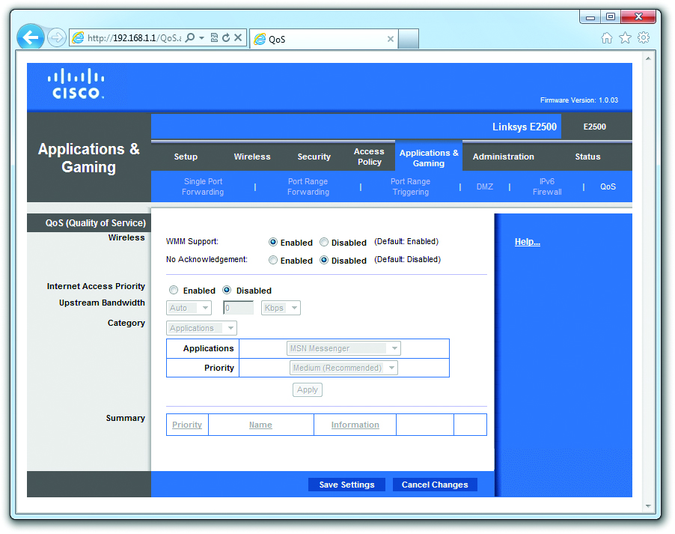
Slow Transfer Speeds
Figure 23.56 QoS

Slide 86
Beyond A+
Important hot topics that are common and important to know:
Online gaming
Chatting
File sharing

Slide 87

Online Gaming
Games employ good old TCP/IP to send information, using ports reserved by the game.
Figure 23.57 Counter-Strike: GO
Notes:
87

Slide 88

Chat
Chat software
The oldest family of chat programs is based on the Internet Relay Chat (IRC) protocol.
A very common IRC chat program is mIRC.
IRC protocols allow for a number of other little extras, such as being able to share files.
Figure 23.59 Google Hangouts in action

Slide 89
File Sharing
File sharing allows users to share files with other users.
BitTorrent protocol is used for delivering Linux distros.
Industry-sanctioned streaming services like Netflix, HBO, and Spotify:
Provide consumers with digital content they want
Eliminate the need for consumers to purchase physical media
Notes:
89
File sharing is one of the most controversial functions of the Internet. While there are many legitimate uses for file sharing, it is also the primary method for pirating music and videos. Programs such as Napster, Kazaa, and BitTorrent allow peer-to-peer sharing of files. These services are not necessarily illegal in themselves, but they have sometimes been used by media pirates to share MP3 files of pirated music and video files. The media industry is trying to stop this. Some people use BitTorrent protocol to make it harder for the media industry to find and punish those who are using file sharing to get and distribute pirated MP3 media files.

Slide 90
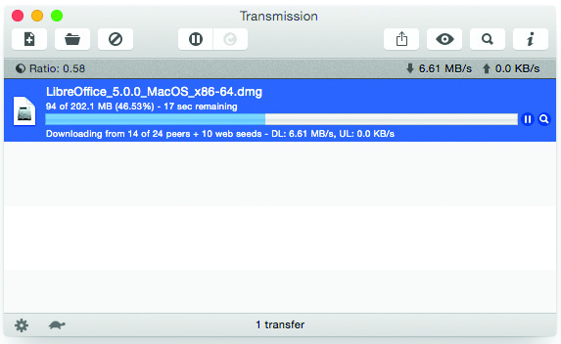
File Sharing
Figure 23.60 Transmission

Slide 91


Slide 92
Summary
Explain how the Internet works
Connect to the Internet
Use Internet application protocols
Troubleshoot an Internet connection

Slide 93


